Slide 1
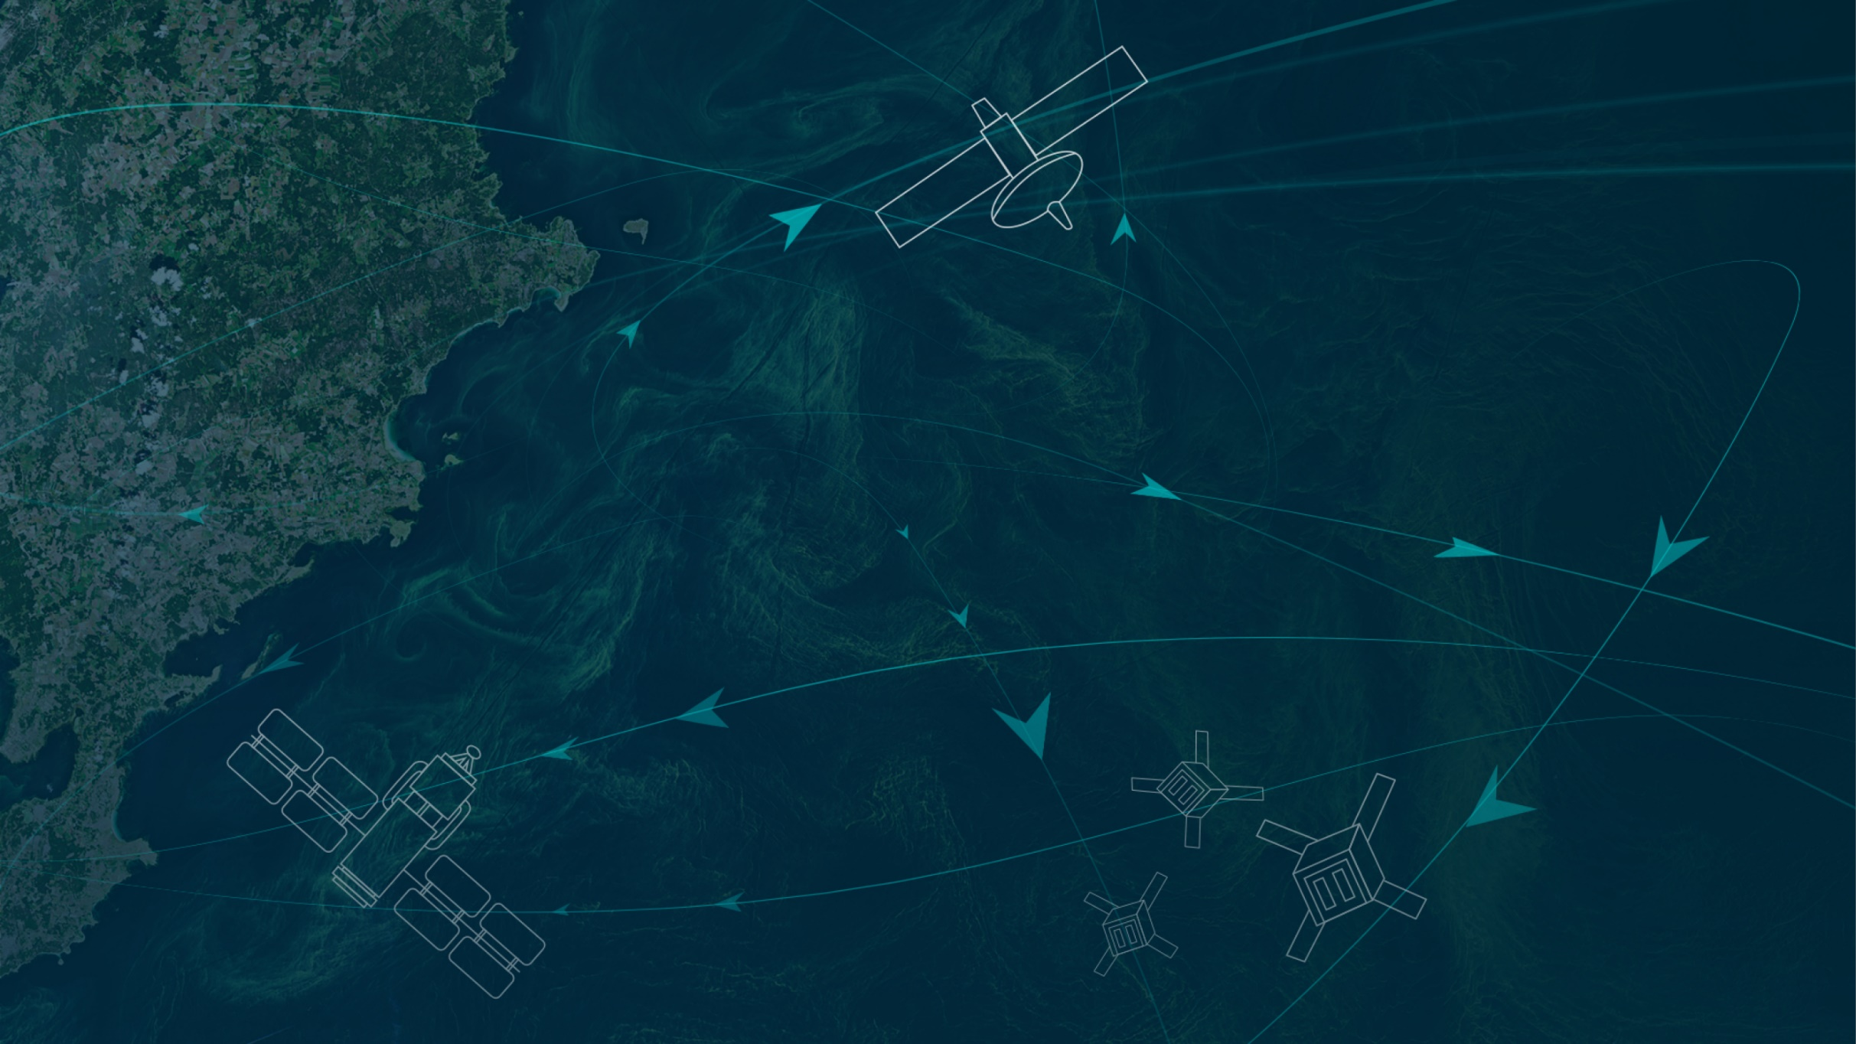
Compounding Ocean Acidification Extremes and Marine Heatwaves from Satellites
Ocean Carbon From Space 2022 Workshop
Luke Gregor, Nicolas Gruber
Environmental Physics, ETH Zürich
Funded by ESA’s OceanSODA project
(Satellite Oceanographic Datasets for Acidification)
Notes:
We’ll look at the product we created to estimate surface ocean DIC/pH, and I’ll give a brief overview of how this was achieved.
Then I’ll show a quick overview of how we’ve used the dataset to detect and describe ocean extreme events.
Lastly, we’ll have a look at the gaps, and future prospects.

Slide 2
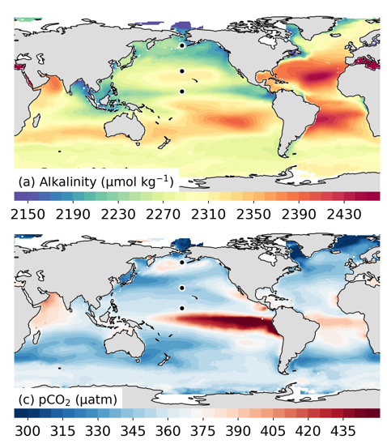
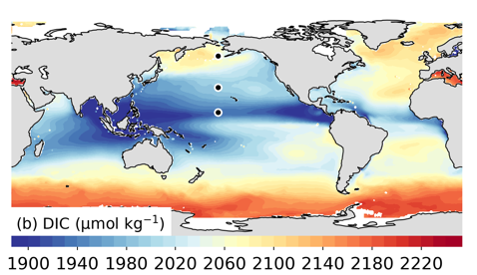
OceanSODA-ETHZ: Maps of ocean carbon based on satellite data
Monthly by 1°x1°
1982-2020 (v2021)
TA and pCO₂ estimated
Calculated: DIC, pH, Ω_{ar/ca}
(Gregor and Gruber, 2021)

Slide 3

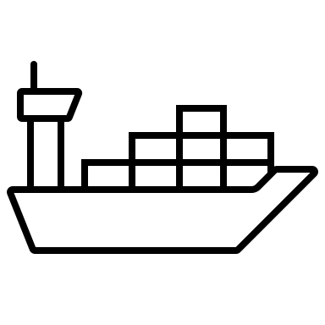

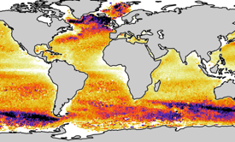
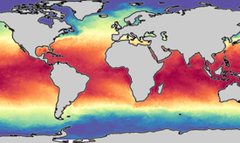
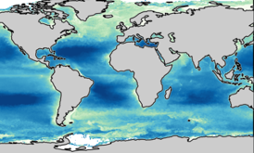


The OceanSODA-ETHZ processing pipeline
MACHINE LEARNING
SURFACE pCO₂
SST, CHL-a, SSS, MLD, +
Ω_{Ca/Ar}
pyCO2SYS
H⁺
Merbach et al. (1973)
refit by Dickson and Millero (1987)
DIC
MACHINE LEARNING
TOTAL ALKALINITY
(Gregor and Gruber, 2021)
INPUT DATA
GAP FILLING
MARINE CARBONATE SYSTEM
Notes:
Filling historically sparse datasets

Slide 4
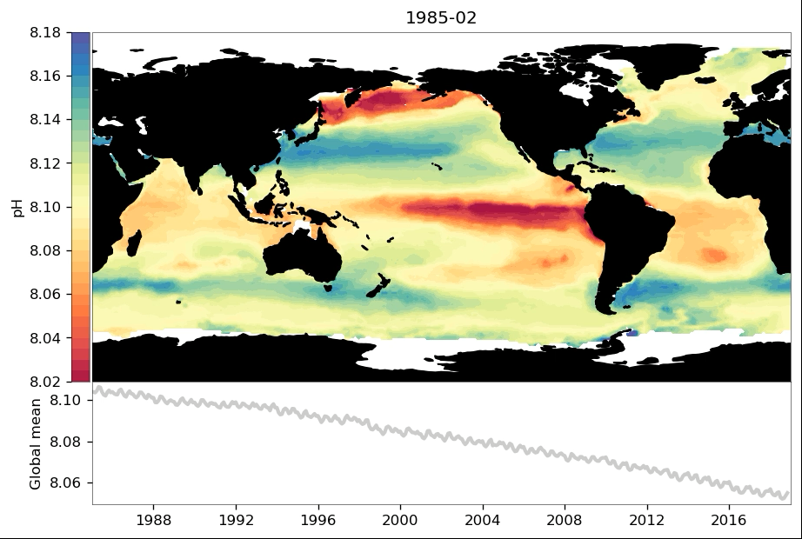
Results: pH time series → a more acidic ocean
(Gregor and Gruber, 2021)

Slide 5
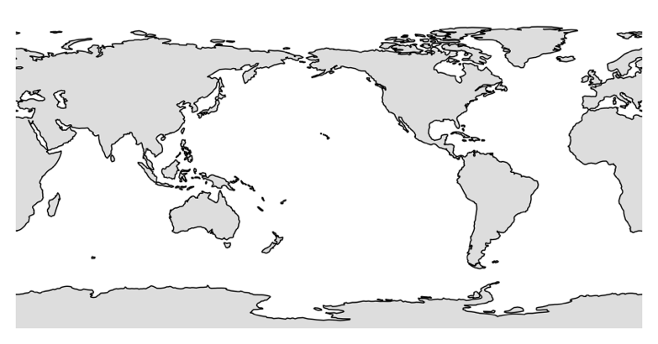
Independent time series comparison with DIC 👍
IRMINGER
HOT
BATS
(Gregor and Gruber, 2021)
Notes:
Bottom line, we have a dataset that we can use for other applications.

Slide 6


Compound extremes: the intersection of MHW + OAXs
Compound extremes
SST
Where a marine heatwave and an ocean acidification extreme overlap / intersect
SST $>{95}^{th} \%$
[H⁺]
Too hot
Marine
Heatwaves
(MHW)
Too sour
[H⁺] Ocean
Acidification
Extremes
(OAX)
Double
Compound
MHW
OAX
$$\left[H^{+}\right]>{95}^{th} \%$$
Hobday et al. (2016, 2018)

Slide 7
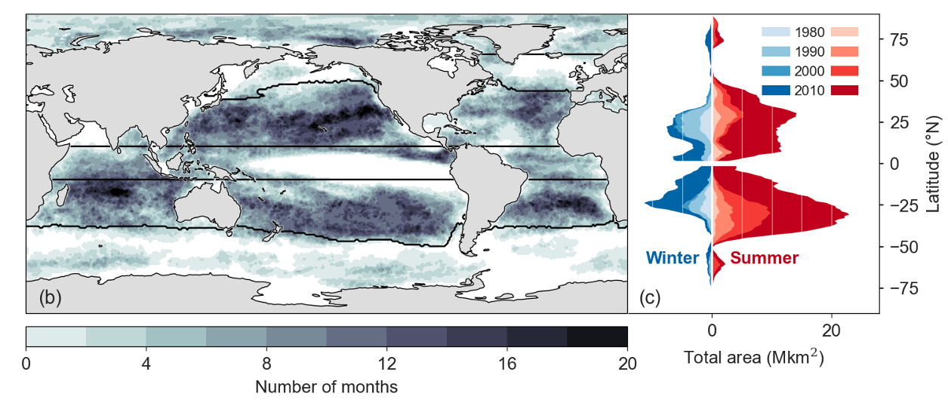
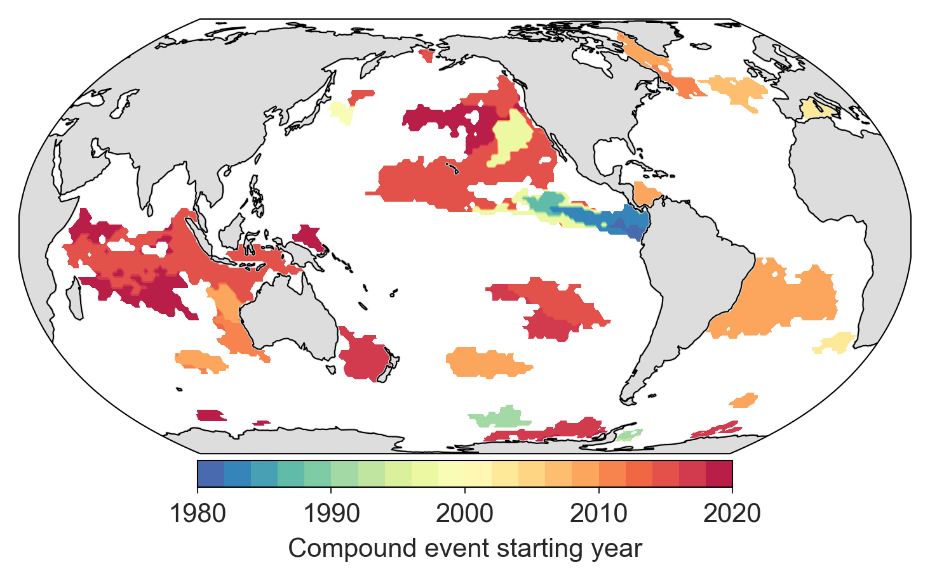
Compound events occur in the mid- and low-latitudes
MedSea (2002) →
The Blob (2014) →
Aus West Coast
(2010)
Tasman Sea (2016)
(Garrabou et al. 2009; Wernberg et al. 2013; Cavole et al. 2016; Oliver et al. 2017)
Notes:
Largely due to the phasing of the seasonal cycle of SST and H+ – in phase in the mid and low latitudes.
Increasing number of events per decade

Slide 8
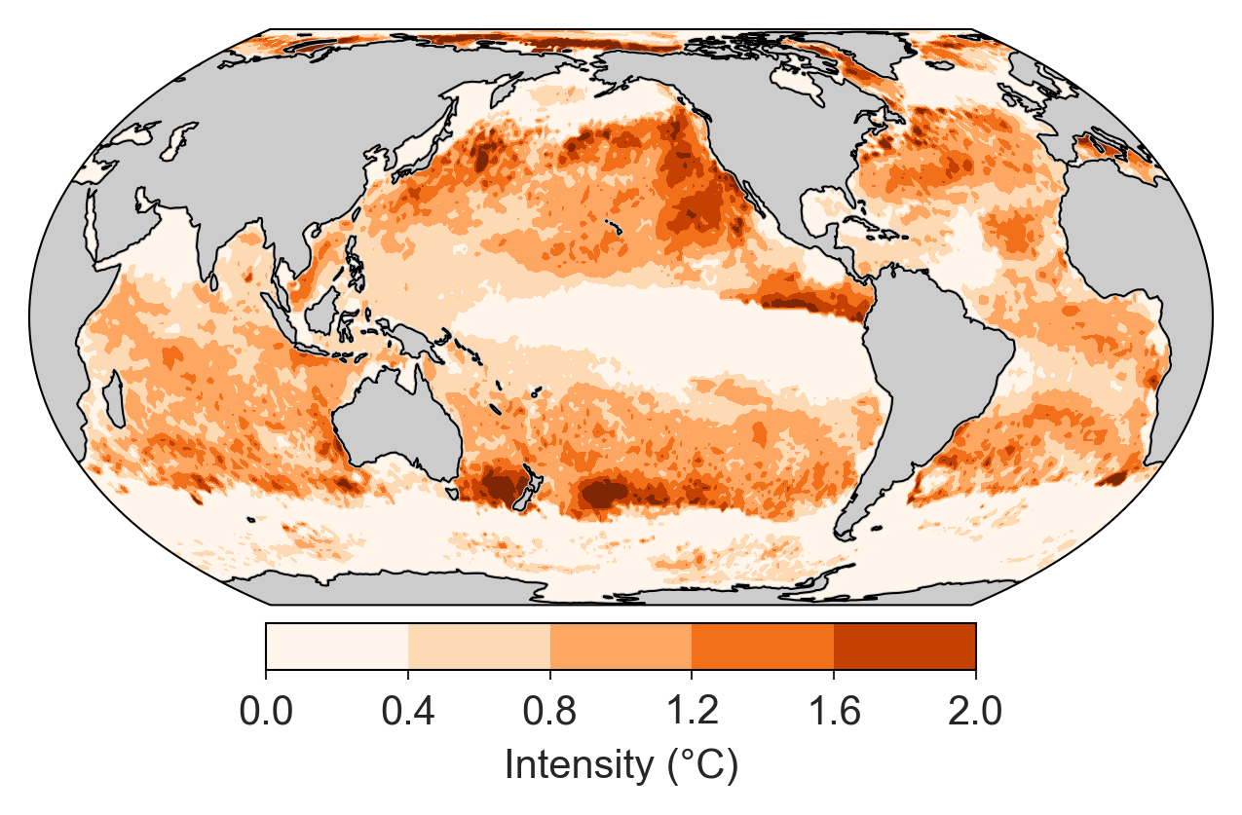
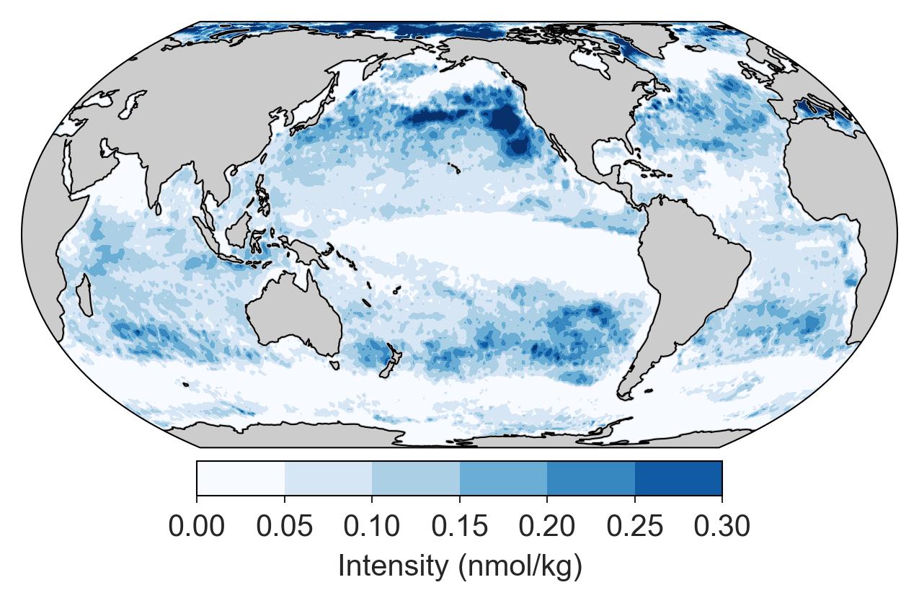
Most intense events: NE Pacific hotspot
Intensity = peak over threshold
MHW
OAX
Maximum Intensity (°C)
Maximum Intensity (nmol kg⁻¹)

Slide 9
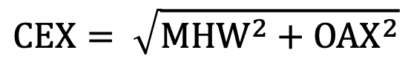
Compound intensity shows the NE Pacific remains a hotspot
$$CEX= \sqrt{MHW^{2}+OAX^{2}}$$
Notes:
Mention current work - understanding the mechanisms of compound extremes - boils down to understanding the drivers of ocean acidifcation extremes.

Slide 10
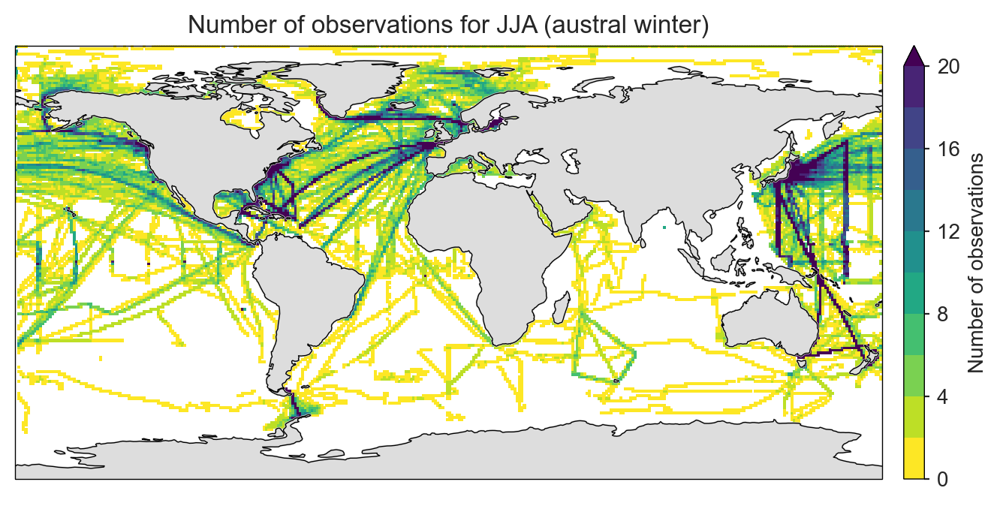
Knowledge Gaps Future outlook
Data paucity
SE Pacific, Indian, SO in winter. We don’t know what happens here – model simulated data for testing
Biological impact of ocean acidifcation extremes on marine organisms
Not enough data to quantify
Species to ecosystem level. Existing studies have focussed on long-term changes
Resolution is limited – monthly data will not capture the short, sharp extremes (< 2 weeks)
1-year outlook
Product with < 3-month lag.
Resolution: weekly by ¼°
Subsurface – proof of concept using Argo floats
5-year outlook
Subsurface
High resolution predictions (weeks to months)
10-year outlook
A NRT “digital twin” of ocean acidification
Thank you for your attention

Slide 11
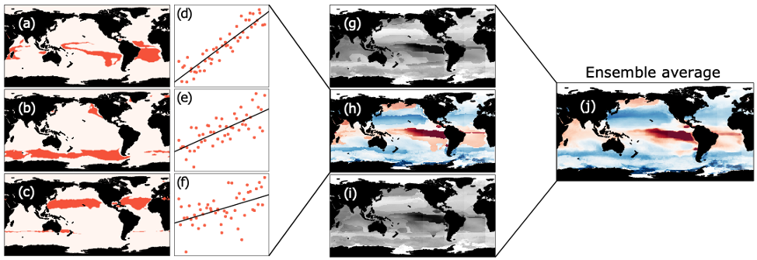
Development of GRaCER algorithm
Biogeochemical province
Clusters (with randomness)
Regression
FFNN / GBM
Ensemble members
Geospatial Random Cluster Ensemble – Regression

Slide 12

UNCERTAINTY ATTRIBUTION
SAMPLING ERROR
PREDICTION UNCERTAINTY
Test subset RMSE
MACHINE LEARNING
REPRESENTATION UNCERTAINTY
SURFACE pCO₂
TOP-DOWN
UNCERTAINTY
Ω_{Ca/Ar}
SST, CHL-a, SSS, MLD, +
e.g. SOCAT monthly
gridded product
temporal
sampling
pyCO2SYS
pH
Merbach et al. (1973)
refit by Dickson and Millero (1987)
DIC
MACHINE LEARNING
TOTAL ALKALINITY
SAMPLING
ERROR
INDEPENDENT
BOTTOM-UP
UNCERTAINTY
Notes:
Representation uncertainty is what we miss because we’re not covering an entire grid cell when we sample. I can illustrate this with the SOCAT monthly gridded data, where nearly 90% of the grid cells have only 2 days of sampling as shown in this figure –this is not taking the consecutive days into account. In highly variable regions, we’d miss a lot of information! We get a crude approximation of the representation uncertainty using a gradient approach in grid cells where enough data is present. We separate this into coastal/continental-shelf and open ocean

Slide 13
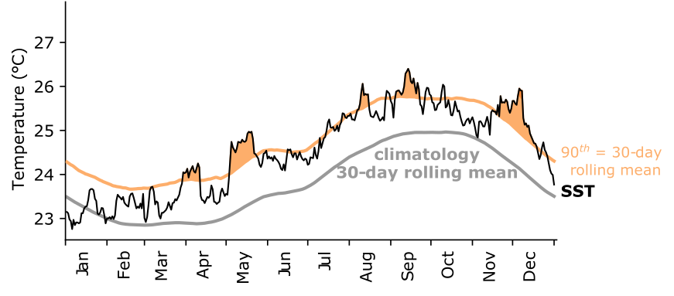
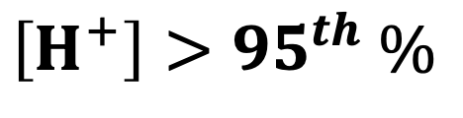
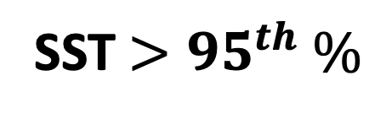
Surface ocean extremes defined with relative thresholds
Marine Heatwaves (MHW)
Ocean Acidification Extreme (OAX)
SST $>{95}^{th} \%$
$$\left[H^{+}\right]>{95}^{th} \%$$
Hobday et al. (2016, 2018)

Slide 14
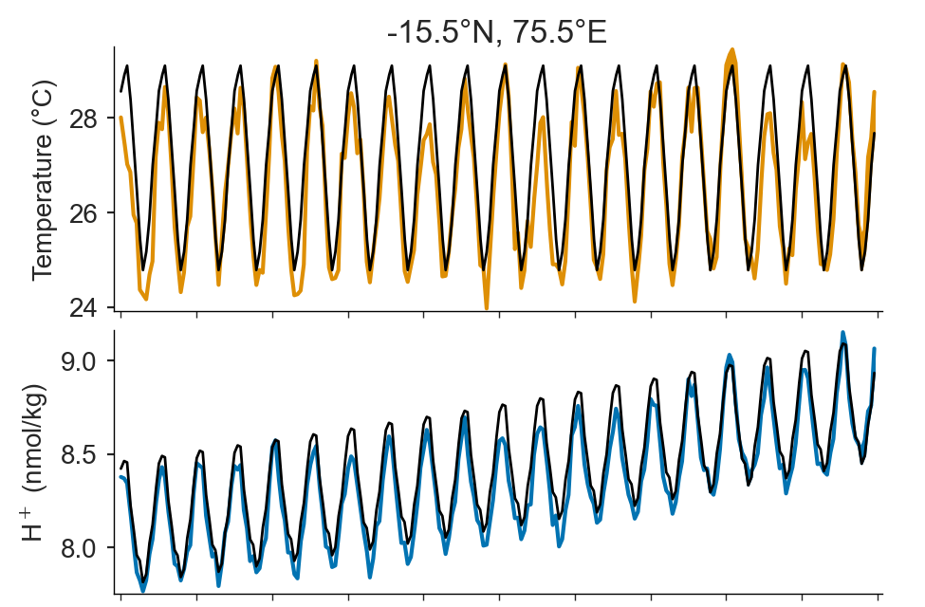
Baseline choices
SST
Fixed baseline threshold (95th %)
1985-2014 (30 yrs)
Trended baseline threshold (95th %)
2nd order polynomial
[H⁺]

Slide 15
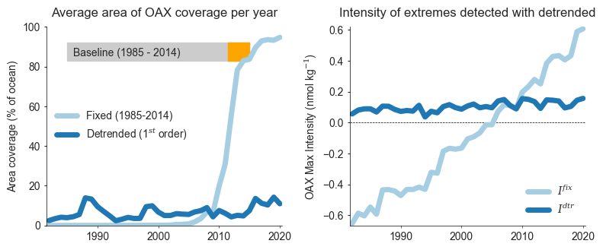
Implications of baseline type
Fixed baseline
intensity
Fixed baseline
area coverage
Trend-based baseline
intensity
Trend-based baseline
Area coverage
Trend-based baseline
Area coverage
Trend-based baseline
intensity

Slide 16
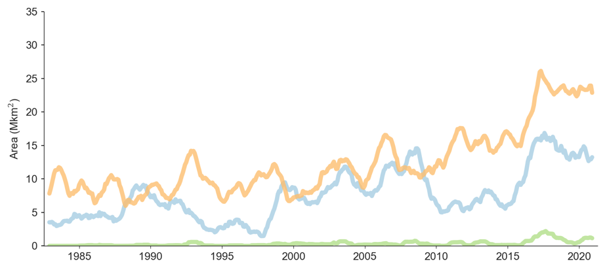
What drives compound events?
Low-Mid Latitudes
El Niño is a strong driver of MHWs
La Nina is a strong driver of OAXs
Increasing occurrence of MHWs results in more compound extremes (baseline choices)
High latitudes
MHWs increase over time but no El Niño signal
OAXs increase slighly over time
Only see a large increase in compound events after 2015
MHWs are often driven by circulation changes etc.,
OAXs are driven by changes in DIC, alkalinity, temperature, and salinity

